Slide 1


Crash Course on Research Methods!

Slide 2


Defining Research
The systematic investigation and study of materials and sources
  Establish facts!
  Reach new conclusions!

Slide 3
Two Types of Research (1)
Basic: Research that answers fundamental questions about phenomena

Slide 4
Two Types of Research (2)
Basic: Research that answers fundamental questions about phenomena
Applied: Research that investigates issues that have direct implications for a specific problem

Slide 5

Taking a Scientific Approach
All scientists use the empirical method
  Empirical Method == Using observation or experiments to reach a conclusion.
  Opposite of speculative, theoretical, or exclusively reason-based approaches (like philosophy)

Slide 6
Theories!
Research is driven by theory
A scientific theory is a set of principles or claims intended to offer some description or explanation of a phenomenon
Theory → Hypothesis (testable prediction)
A hypothesis must be falsifiable! (otherwise it cannot be scientific)

Slide 7
Scientific Method (2)
Observe/
Question
Hypothesis
Experiment/
Test Hypothesis
Analyze Results
Form Conclusions
Theories are part of the observing/ questioning stage.

Slide 8
The Scientific Method
Commonly used when designing lab-based experiments
Lab-based experiment:
  How does manipulating one variable impact another?
Two main types of variables:
  Independent variable: Thing the researcher is manipulating or changing
  Dependent variable: Outcome being measured.
  How does x change as a function of y?

Slide 9
Experimental Designs
Experiments involve carefully controlled procedures in which one or more variables are manipulated
  Can infer causation/can explain WHY one variable affects another!
Simplest experiment contains 2 groups:
  Group that receives the treatment (e.g., experimental drug)
  Group that receives a placebo (e.g., control group)
  Is there a difference between the two groups? If yes, what’s the direction?

Slide 10
Complex Experimental Designs
Common to have studies w/ multiple independent or dependent variables
Why? Can answer more complicated questions!
Example: Cohen et al. (1996) “Culture of Honor” Study
What is a culture of honor?
  Those that emphasize family or personal reputation
  Very common in the American South
Research Question: How do individuals from this background respond to aggression?

Slide 11
Cohen et al. (1996)
The study design:
  Half of the participants were from Southern US, half from Northern US (IV #1)
  Cover story: Participants though they were completing a study on blood sugar. Filled out a questionnaire and provided a saliva sample. Asked to take the paperwork to an office down a narrow hall when finished
  Manipulation: A confederate is blocking the way. They move to let the participant pass. On the way back, confederate bumps into the participant and 1) insults them publicly, 2) insults them privately, or 3) does not bump them (IV #2)
  Participants return to lab, are told they are going to take a stress test where they will receive an electric shock. Asked to pick a voltage between 10 and 250.
  Dependent Variable: What level of shock does the participant choose?
  Outcome: Those from an honor culture AND insulted publicly consistently picked a higher level, presumably in a display of toughness

Slide 12
How to Measure Variables
There is an important gap between the variables of our theory and the variables we can directly observe
Variables exist at two levels:
  Theoretical/Conceptual: Specified by theory
    Self-esteem, attraction, happiness, etc.
  Measured: Variables in observable form
    We can’t “see” these processes but infer their existence indirectly
  Example: Learning as measured by test performance

Slide 13

Measuring Variables
The process of defining conceptual variables into a form that can be measured is operationalization
  Conceptual variable: Attraction
  Operationalization: How closely you sit next to someone
  What else??

Slide 14
Finding Participants
When selecting a samples for a study, its important that the sample is representative of your population!
  The sample must reflect the characteristics of the population of interest
Populations: Broad groups of people in which researchers may be interested
  Adolescents
  First generation immigrants
  Males between the ages of 18 – 25

Slide 15
Why use samples?
Impossible to measure everyone in our population!
Example: Target population is College students; Sample 100 students from MSU

Slide 16
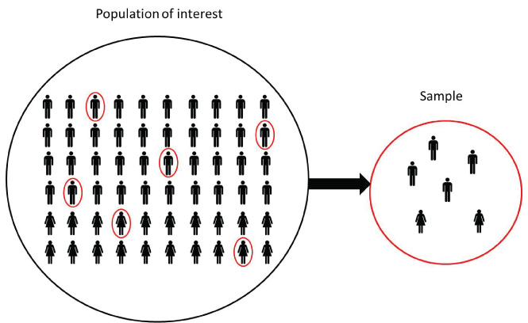
How to get representative sample?
Random assignment!

Slide 17
Potential Problems w/ Experiments
External Validity: Can findings replicate outside of the lab in a messy, non-controlled environment?
Confounding variables: Is there some outside, non-measures thing that could also be influencing our findings?

Slide 18
Confounding Variables (1)
Confounding Variable
Affects the relationship between the two variables
Independent Variable
Dependent Variable

Slide 19
Confounding Variables (2)
Age
Less Excersise
Greater Heart Disease Risk

Slide 20
Field Research
Because social psych focuses on interactions, many questions are difficult to investigate in the lab
Field experiments use real-world settings to investigate a variety of issues

Slide 21
Field Research Example
Isen & Levin (1972) Study of helping behaviors
Research Question: Will individuals who have been helped in some way be more likely to help others?
Scenario: Researchers observed individuals at a pay phone. Half “randomly” found a dime in the change slot. Participant then observes a confederate drop a stack of papers. Will people who found the dime be more willing to help than the control group?
Yep! Almost 100% of those who found a dime helped (vs. 1/25 in the control group….)

Slide 22
Observation
Field research makes use of systematic observation
  Carefully watching people and seeing what they do
Two types:
  Naturalistic observation
    “Real-life” observations
    Do children model adult behavior?
  Structured observation
    Researchers create a situation likely to result in the type of behavior in which they are interested
What type of observation was the Pay Phone study?

Slide 23
Observation
When to use naturalistic observation?
  Any time its unethical or impractical to assign people to different groups or conditions
Example: Cialdini et al. (1976)
  Observed that students are more likely to wear clothing w/ school logo after win by the football team
  Why not systematic?

Slide 24
Observation
Ethical issues w/ observation:
  Consent! Participants have rights and typically must provide informed consent before they can participate
  But providing informed consent would ruin observational studies….
  Participants in observational studies often don’t know they are being watched and might act differently if they knew

Slide 25
Self-Report Measures
Researchers have individuals answer questions about a topic of interest
  Example: measuring self-esteem using a questionnaire, open-response questions, etc.
  Note: When researchers ask participants orally, the self-report is referred to as an interview
Self-reports are useful because they provide direct information about a topic

Slide 26
Survey Research
Arguably the most common type of self-report measure
Commonly used to assess attitudes, values, and behaviors
Advantage: Easy to administer and can be used on large groups of participants (Thanks internet!)
  Amazon’s Mechanical Turk
  Prolific

Slide 27
Large-Scale Survey Example
The World Values Survey II
  Assessed respondents from 19 countries
  Found a stronger relationship between income levels and subjective well-being in poorer countries

Slide 28
Disadvantages of Surveys
Must be careful when designing them! Do the questions really assess whatever you’re trying to measure?
  Internal validity
Are participants truthfully responding?
  Especially important for sensitive topics like prejudice, sexual preferences, etc.
  The social-desirability problem
  Ensuring that responses are anonymous helps with this!

Slide 29
Issues in Social Psych Research
~96% of participants in psych studies come from Western, democratic, industrialized countries
Usually these participants are also psych students (or at least currently taking a psych course)
Sometimes this is okay (basic cognitive processes are universal)
But individual differences play a role in many social phenomena
  Examples: Relationships, aggression, helping behaviors, etc.

